Slide 1
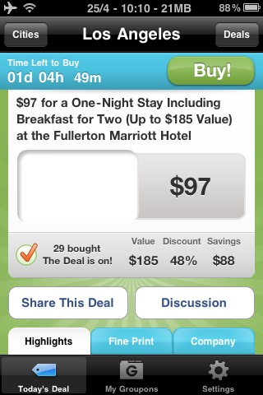
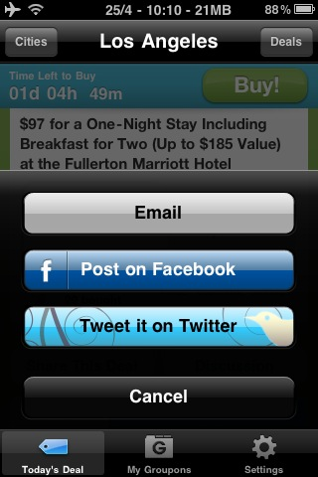
1) TELL A FRIEND
When browsing promotions, user can tell a friend thru email, FB or twitter. A URL link of the promotions web page is sent via email, posted on FB or Twitter.

Slide 2
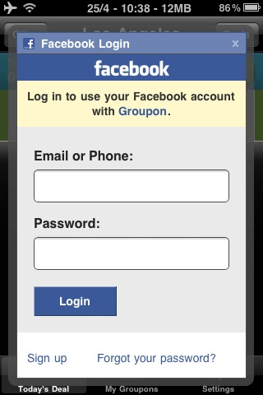
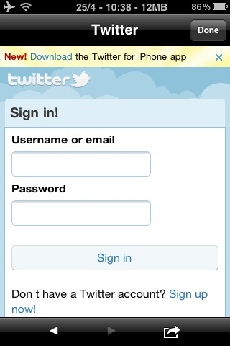
Facebook, & Twitter login opens within the iphone app. The Email is also sent within the app. After sending email or posting on Facebook and Twitter, the user is returned back to the product promotions page.

Slide 3
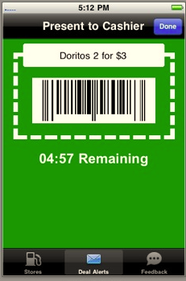
2) REDEEM A PROMOTION AT RETAIL STORE
Redeem
Company creates a promotion – by uploading an image (either a bar code image or a coupon graphic) thru the CMS. Set an expiry date for the promotion.
Iphone app displays a countdown timer for this promo.
User presents the promo image to the cashier. The cashier taps on a button “Redeem”, and countdown timer changes to “redeemed”.
After this, the bar code or promotion ad is disabled

Slide 4
AFTER A REDEMPTION IS DONE:
Redeemed
Either stamp the word “REDEEMED”
Or
change the button to “Redeemed”
REDEEMED!

Slide 5


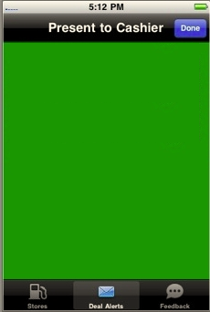
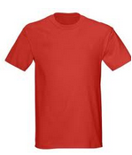
** NEW REQUIREMENT ** - Link to Merchant’s e-commerce store
Orders a Product online
(Magento website)
Online Payment successful.
Pick up your product from our retail shop
A collection slip is emailed to the customer.
Customer prints the slip, bring to the relevant retail shops to pick up the product..
Your order:
If Customer has the iPhone app, the collection details is push to the iPhone app also.
Collected!

